Slide 2
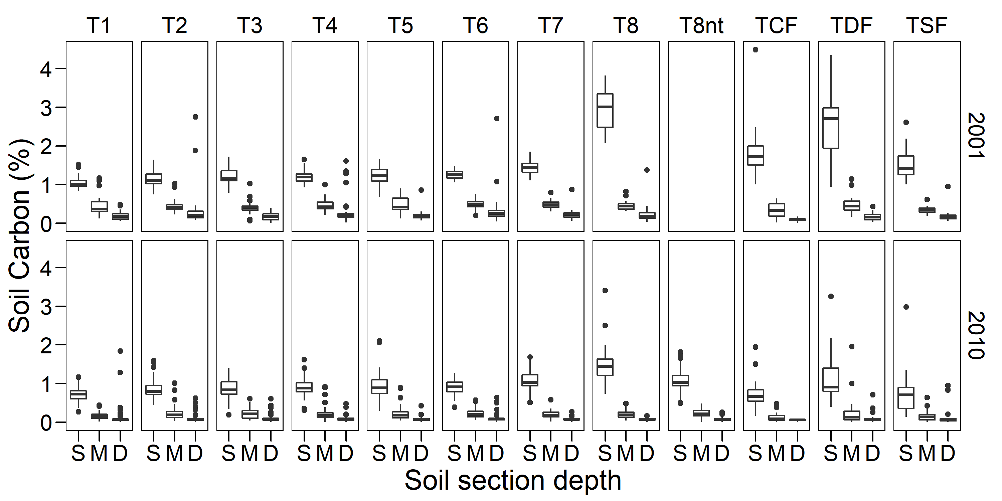
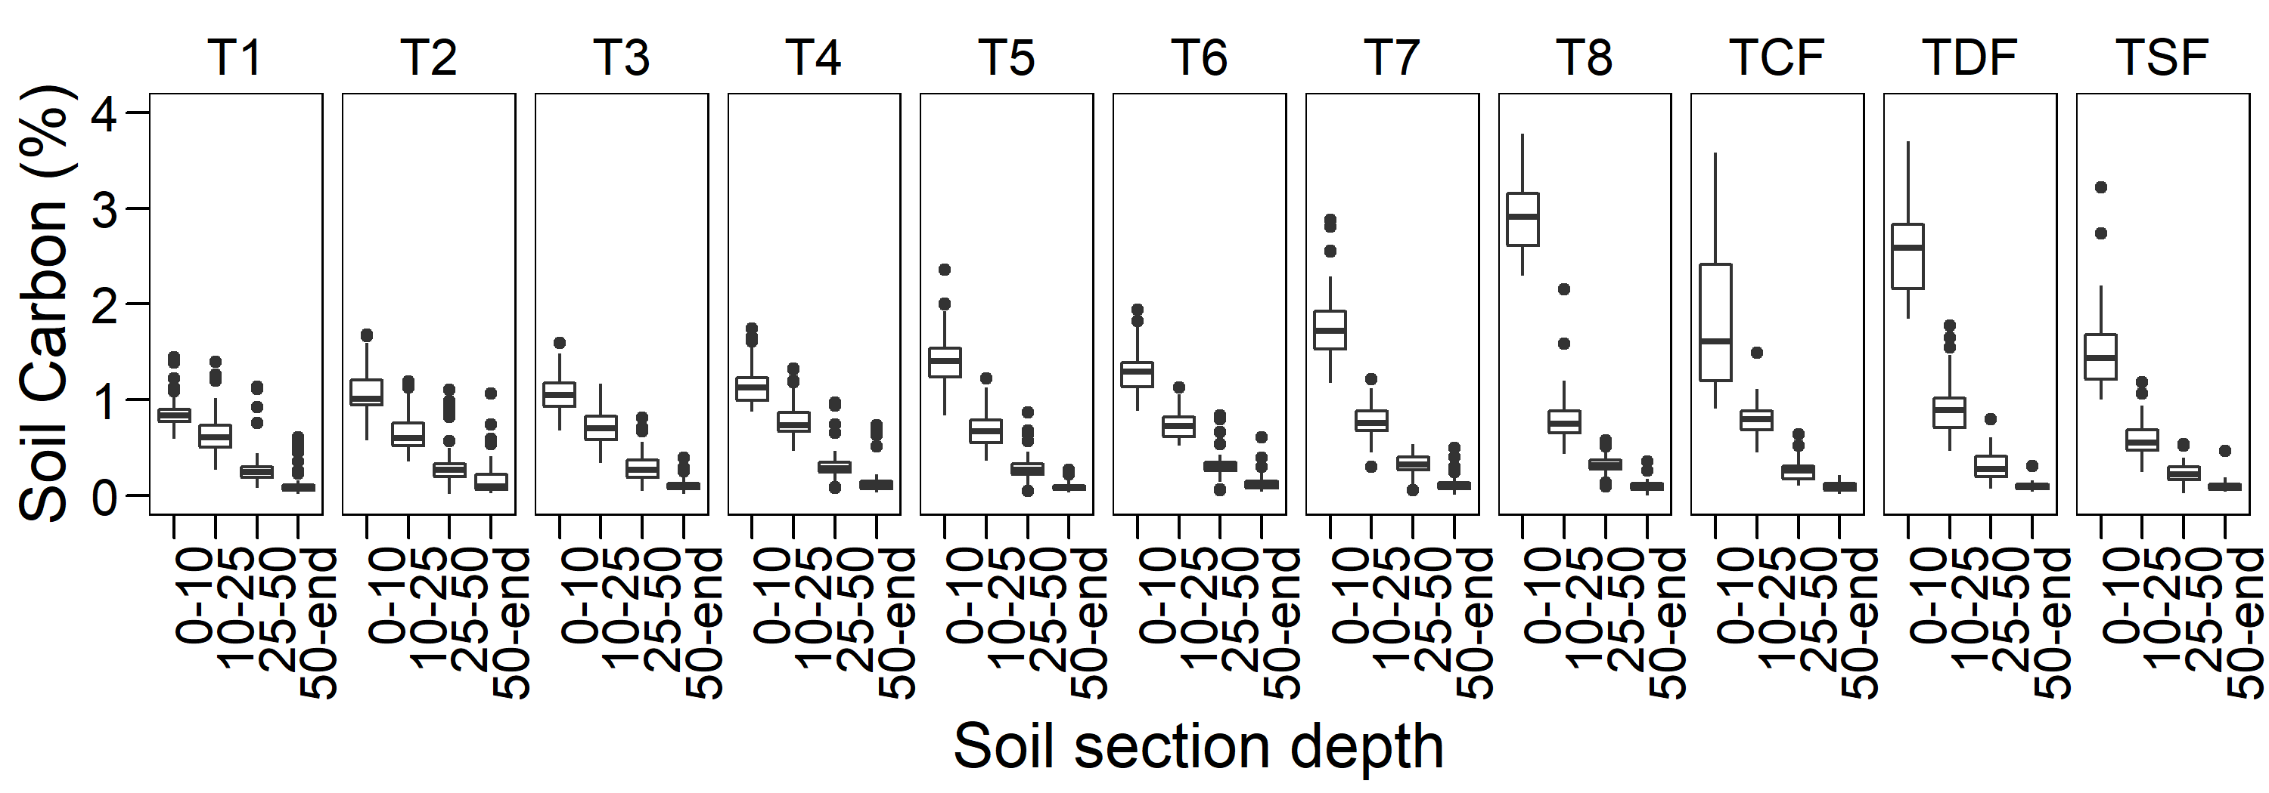
2013

Slide 3
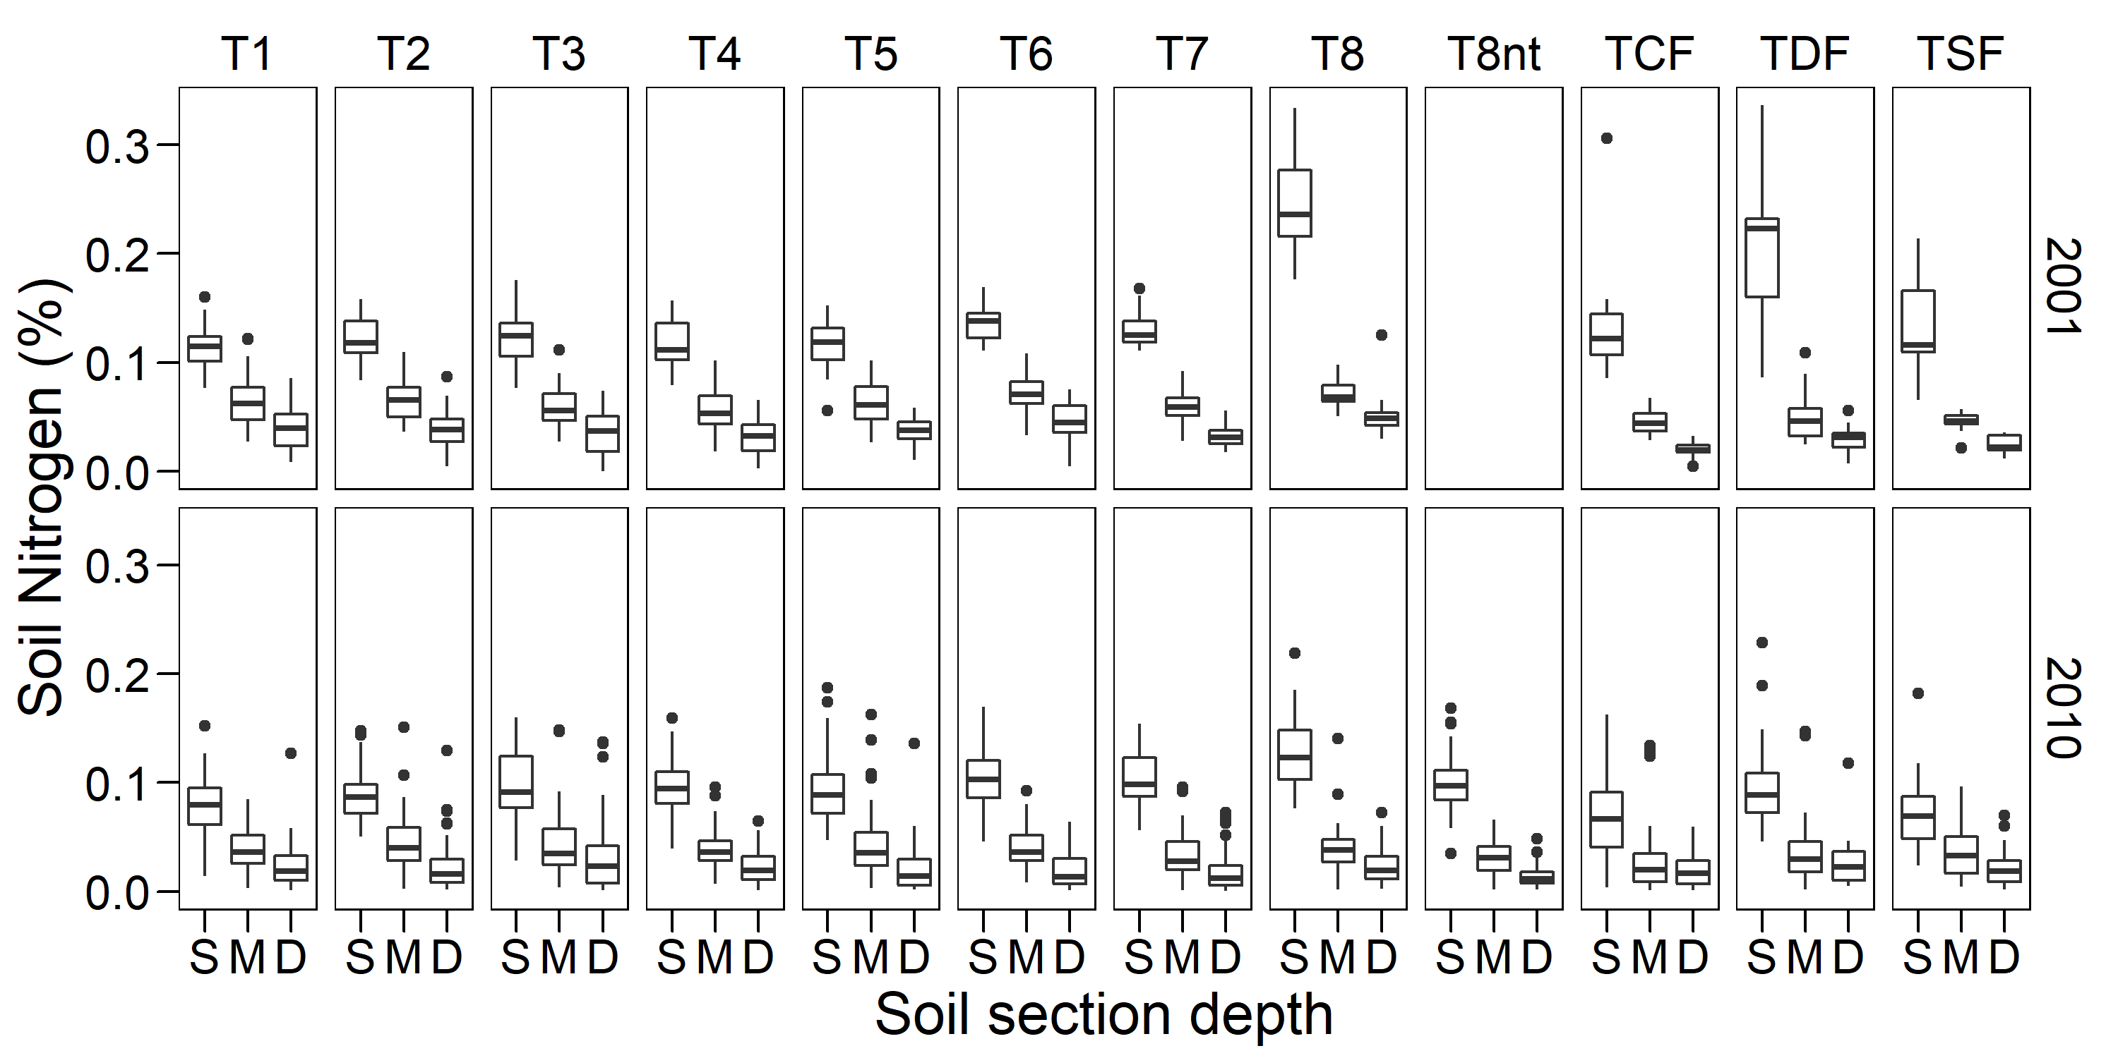
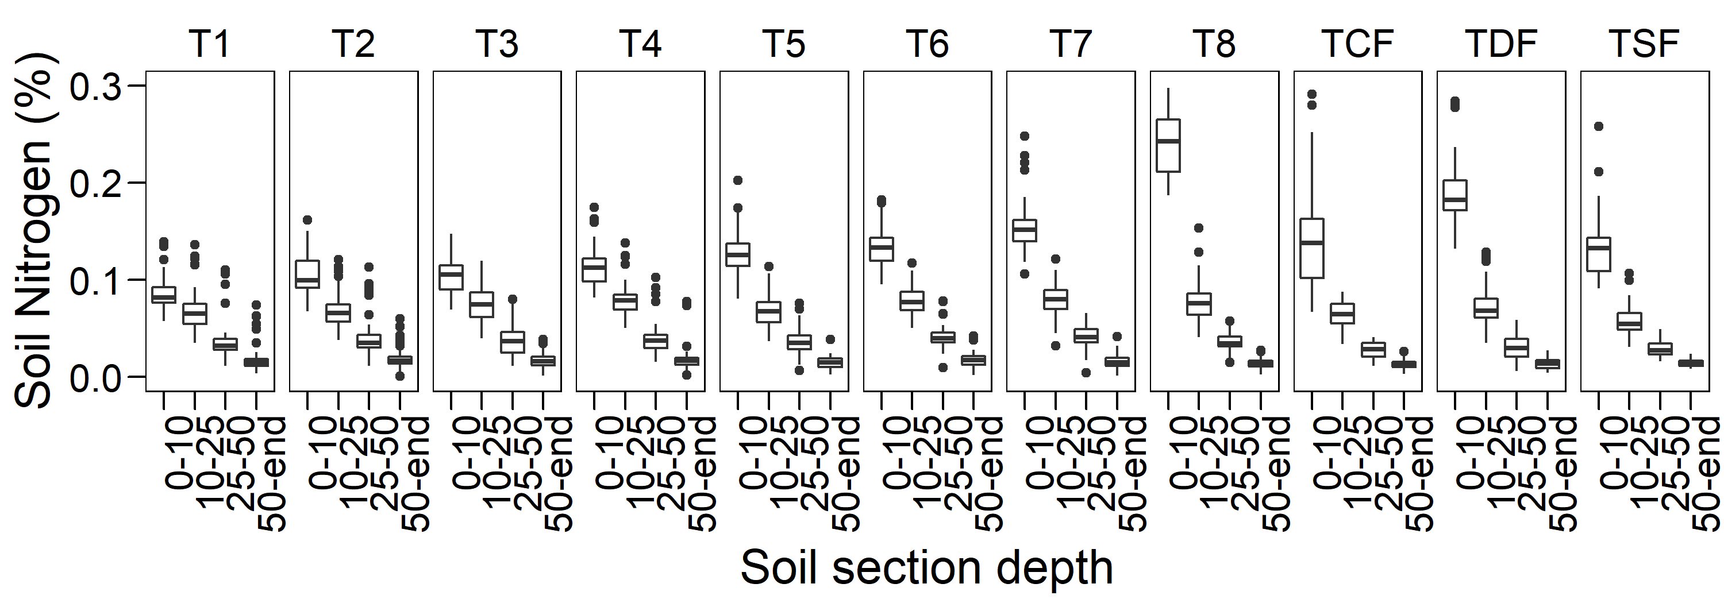
2013

Slide 4
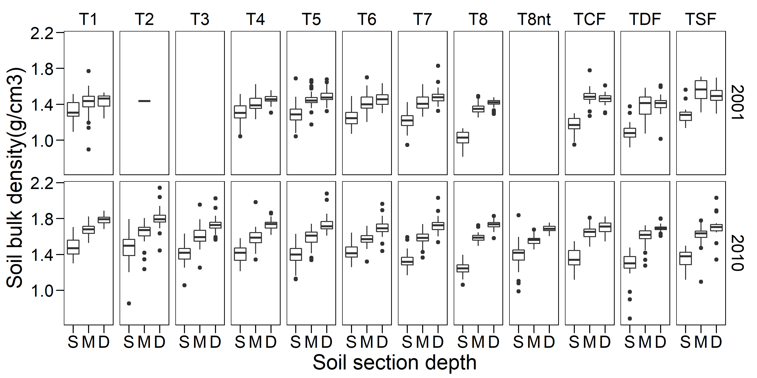
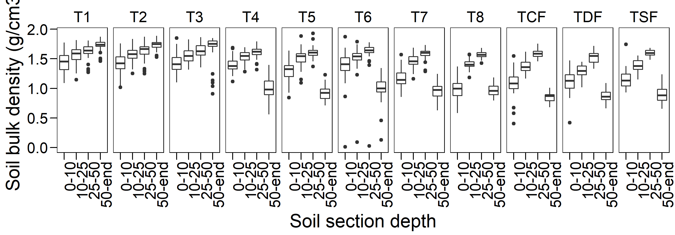
2013

Slide 5
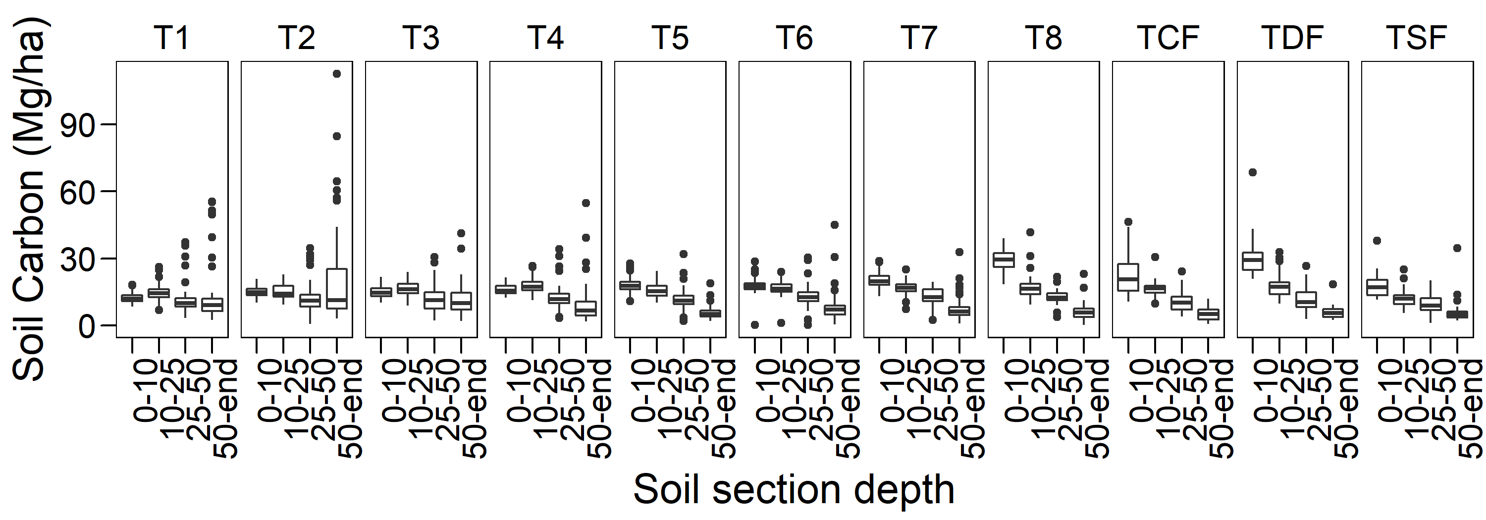
merge(x = df1, y = df2, by = "CustomerId", all.x = TRUE)
https://stackoverflow.com/questions/1299871/how-to-join-merge-data-frames-inner-outer-left-right
2013

